Slide 1
Shuttle
eclipse
eclipse
An Instant Model Synchronization Assistant for GMF Editors Based on Concept Synchronization
Kao, Chen-yi, WTA Lab

Slide 2
Outline
Motivation
Related Search
Concept Synchronization
Shuttle Links Model Elements and Concepts
Text Boundary Detection of Shuttle
GMF Integration of Shuttle
Shuttle Behavior & Partial Structure
Demo…
Future Works

Slide 3
Coming Next…
Motivation
Related Search
Concept Synchronization
Shuttle Links Model Elements and Concepts
Text Boundary Detection of Shuttle
GMF Integration of Shuttle
Shuttle Behavior & Partial Structure
Demo…
Future Works

Slide 4
Motivation
What does model synchronization still need?
Instant (better automatic and intuitive) roundtrip engineering anytime everywhere
NOT ONLY in synchronizing GUI/Java or UML/Java, etc., but generally ALL kinds of models
Refactoring beyond exact string matching
E.g. renaming variable – in variable name and comment there may be different occurrences of the equivalent term.
Notes:
- GUI example, scroll, scrolling…?
- Delete, remove, erase…

Slide 5
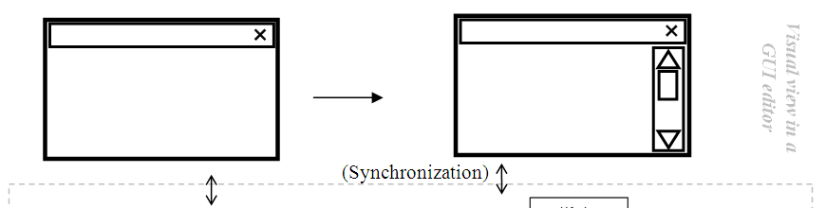
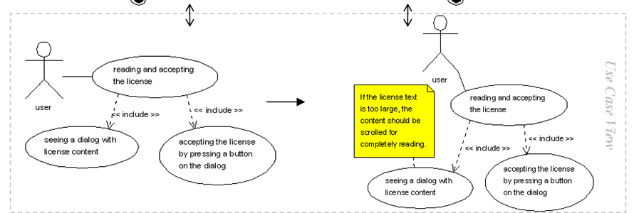
Motivation (cont.) A GUI design example

Slide 6
Coming Next…
Motivation
Related Search
Concept Synchronization
Shuttle Links Model Elements and Concepts
Text Boundary Detection of Shuttle
GMF Integration of Shuttle
Shuttle Behavior & Partial Structure
Demo…
Future Works

Slide 7
Related Research Graph/Model Transformation
AGG, CODEX, UMLX, ATL, etc.
Another (transformation) language to learn
Did not automatically transform graphs/models according to element text
Treating element text as black box
Element text A
Element text B
Element text C

Slide 8
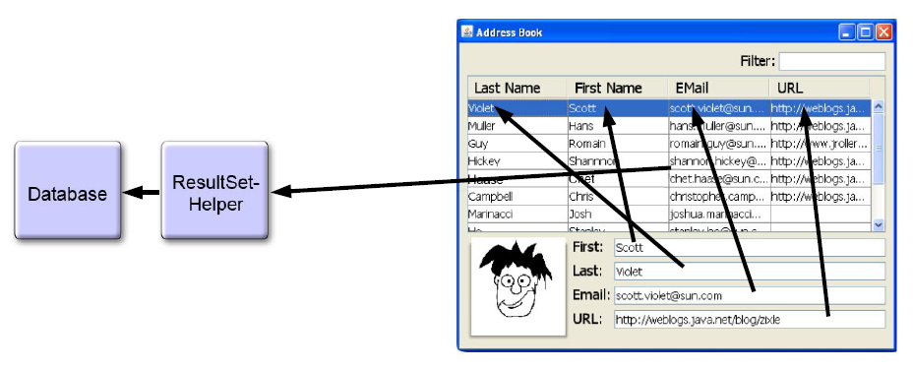
Related Research (cont.) Data Binding
Beans Binding (JSR 295), JFace Data Binding

Slide 9
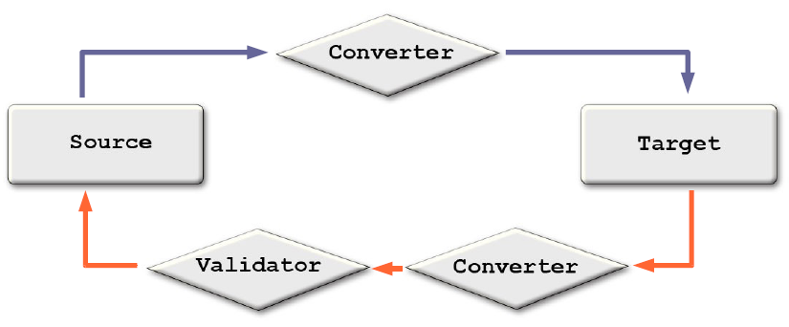
Related Research (cont.) Data Binding
Assign binding, then synchronization is automatic

Slide 10
Coming Next…
Motivation
Related Search
Concept Synchronization
Shuttle Links Model Elements and Concepts
Text Boundary Detection of Shuttle
GMF Integration of Shuttle
Shuttle Behavior & Partial Structure
Demo…
Future Works

Slide 11
Concept Synchronization
Ontology
…is often conceived as a set of classes (concepts), relations, functions, axioms and instances (Gruber, T.R., 1993)
Information Retrieval
Concept search – beyond keyword search
Concept – semantically related keywords

Slide 12
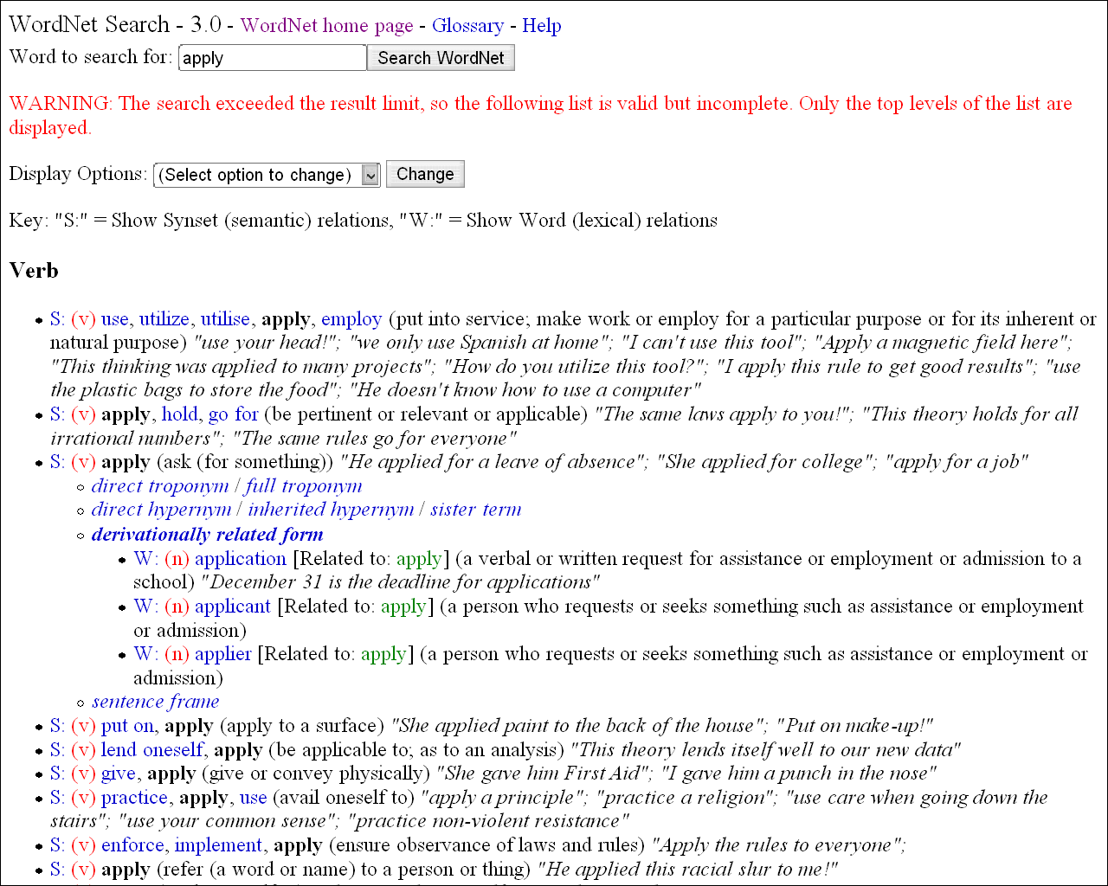
Concept Synchronization (cont.) WordNet

Slide 13
Concept Synchronization (cont.)
By concept search, Web pages of the same concept can be found together, and how about model elements?
Shuttle: Concept based on WordNet Synset

Slide 14
Coming Next…
Motivation
Related Search
Concept Synchronization
Shuttle Links Model Elements and Concepts
Text Boundary Detection of Shuttle
GMF Integration of Shuttle
Shuttle Behavior & Partial Structure
Demo…
Future Works

Slide 15
Shuttle Links Model Elements and Concepts – MIT Java WordNet Interface (JWI)
From String to Synset
1. WordNet Dictionary Lookup
edu.mit.jwi.dict.IDictionary
IIndexWord getIndexWord(java.lang.String lemma, PartOfSpeech pos);
2.1 Concept Search - Basic Concept Search
edu.mit.jwi.item.IIndexWord
IWordID[] getWordIDs();
edu.mit.jwi.item.IWordID
ISynsetID getSynsetID();

Slide 16
Shuttle Links Model Elements and Concepts (cont.) 2.2. Extended Concept Search
edu.mit.jwi.item.IWord
IWordID[] getRelatedWords();
Words in other part-of-speeches (POS, one of NOUN, VERB, ADJECTIVE and ADVERB)
And like Basic Concept Search
edu.mit.jwi.item.ISynset
ISynsetID[] getRelatedSynsets();
Hypernym（泛義／上位詞）, Hyponym（特義／下位詞）、 Meronym（成分詞）, Holonym（合成詞） Synsets…, under the same POS
To resolve ISynset:
ISynset edu.mit.jwi.dict.IDictionary.getSynset(ISynsetID)

Slide 17
Coming Next…
Motivation
Related Search
Concept Synchronization
Shuttle Links Model Elements and Concepts
Text Boundary Detection of Shuttle
GMF Integration of Shuttle
Shuttle Behavior & Partial Structure
Demo…
Future Works

Slide 18
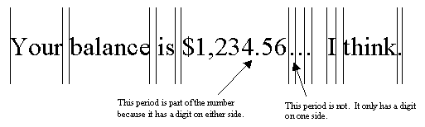
Text Boundary Detection of Shuttle – java.text.BreakIterator
Sentence boundary analysis
BreakIterator BreakIterator.getSentenceInstance()
void BreakIterator.setText(String newText)
int BreakIterator.next()
String String.substring
(int beginIndex, int endIndex)
Word boundary analysis
BreakIterator BreakIterator.getWordInstance()
…

Slide 19
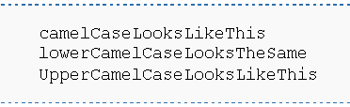

Text Boundary Detection of Shuttle (cont.)
To handle compound words with CamelCase/underscore
We design CompoundWordBreakIterator
Sub-classing BreakIterator

Slide 20
Text Boundary Detection of Shuttle (cont.) The GUI example reviewed

Slide 21
Text Boundary Detection of Shuttle (cont.) When model element text is modified…
Impact Area
Likely
Changing
Boundary
Levenshtein Editings
boundary
ThisIsACameltextWithUnderscores_ANDSubwords
Impact Segment

Slide 22
Coming Next…
Motivation
Related Search
Concept Synchronization
Shuttle Links Model Elements and Concepts
Text Boundary Detection of Shuttle
GMF Integration of Shuttle
Shuttle Behavior & Partial Structure
Demo…
Future Works

Slide 23
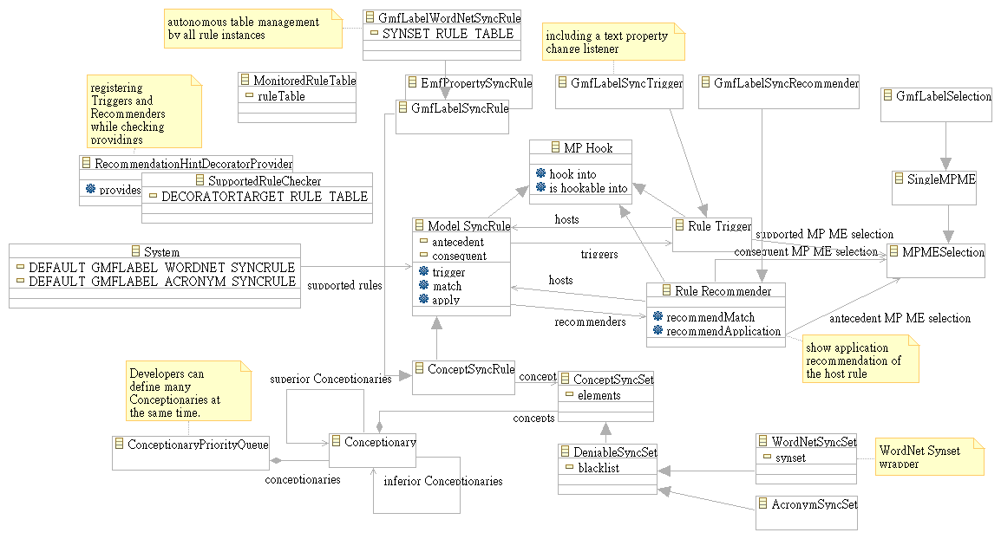
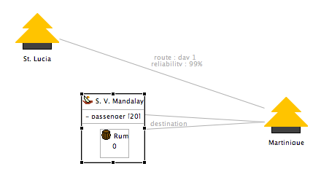
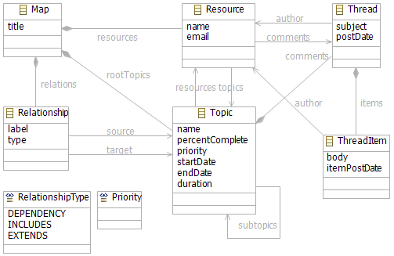
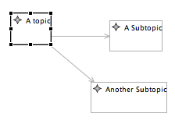
GMF Integration of Shuttle GMF Labels…

Slide 24
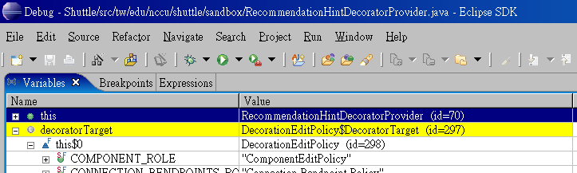
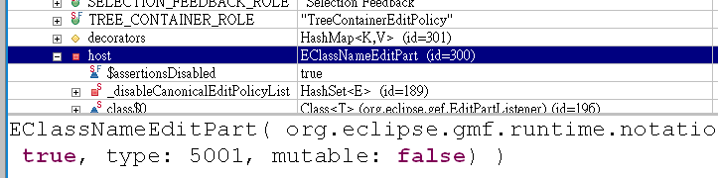
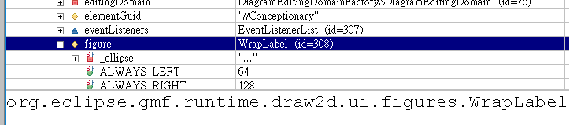
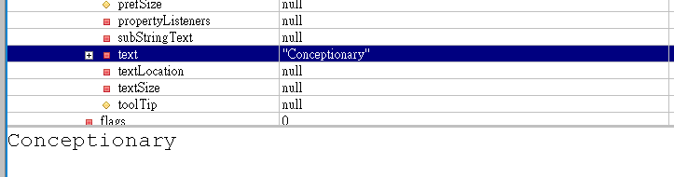
GMF Label in runtime

Slide 25
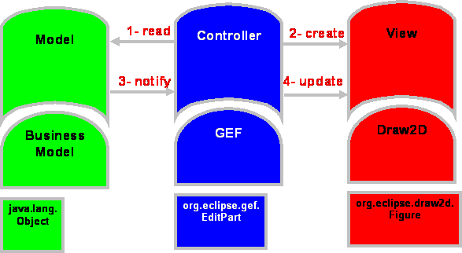
GMF Integration of Shuttle (cont.) GEF Model-View-Controller Pattern
(from GMF SDK Help)

Slide 26
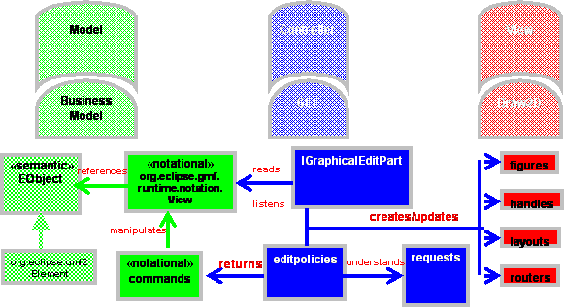
GMF Integration of Shuttle (cont.) GMF Model-View-Controller Pattern
(from GMF SDK Help)

Slide 27
GMF Integration of Shuttle (cont.) Shuttle focuses on Labels…

Slide 28
GMF Integration of Shuttle (cont.) What Shuttle did is…
Monitoring Label element first
Decoration Service
Implementing for retrieving Labels to decorate/monitor
EditPartListener
Implementing for detecting change
Draw2D WrapLabel
Retrieving Text
Visual synchronization recommendation
Recommendation hint as a wrapper for GMF IDecoration
Decoration Service
Recommendation as WrapLabel Tooltip

Slide 29
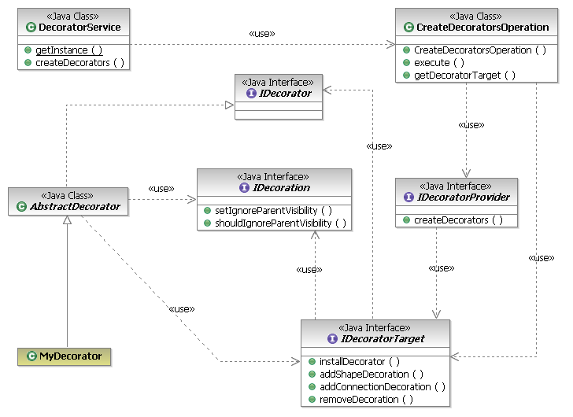
GMF Decoration Service
Shuttle: RecommendationHint as wrapper
Shuttle: Recommendation-HintDecoratorProvider
Shuttle: Recommendation-HintDecorator
createDecorators(IDecoratorTarget decoratorTarget)
Presentation Decorator Providers extension point

Slide 30
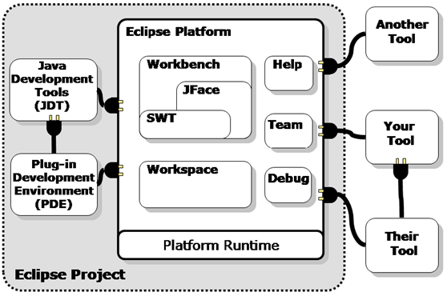
Eclipse Plug-ins and Extension Points
GMF - plug-in of Eclipse; Shuttle - plug-in of GMF

Slide 31
GMF Integration of Shuttle (cont.) Extending Presentation Decorator Providers Extension Point
Plugin.xml of Shuttle
<?xml version="1.0" encoding="UTF-8"?>
<?eclipse version="3.2"?>
<plugin>
<extension
id="ShuttleRecommendationHintDecoratorProvider“
name="Shuttle Recommendation Hint Decorator Provider"
point="org.eclipse.gmf.runtime.diagram.ui.decoratorProviders">
<decoratorProvider
class="tw.edu.nccu.shuttle.sandbox.RecommendationHintDecoratorProvider">
<Priority name="Medium"/>
</decoratorProvider>
</extension>
</plugin>

Slide 32
Coming Next…
Motivation
Related Search
Concept Synchronization
Shuttle Links Model Elements and Concepts
Text Boundary Detection of Shuttle
GMF Integration of Shuttle
Shuttle Behavior & Partial Structure
Demo…
Future Works

Slide 33
Shuttle Behavior
Retrieving element text from GMF editors
Linking elements and concepts
Detecting text boundaries
Looking-up and searching concepts in WordNet
Generating rule instances
If modified text link to existing rules, then trigger them and show recommendations/hints
Recommendation is accepted (manual operation for now)
Recommendation is rejected (manual operation for now)

Slide 34
Shuttle Structure (Partial)
Platform Portals & Utilities

Slide 35
Shuttle Structure (Partial) (cont.)
Concept

Slide 36
Rule/Trigger/
Recommender
Shuttle Structure (Partial) (cont.)

Slide 37
Application Rules
Shuttle Structure (Partial) (cont.)

Slide 38
Structural
Rule Related
Shuttle Structure (Partial) (cont.)

Slide 39
Coming Next…
Motivation
Related Search
Concept Synchronization
Shuttle Links Model Elements and Concepts
Text Boundary Detection of Shuttle
GMF Integration of Shuttle
Shuttle Behavior & Partial Structure
Demo…
Future Works

Slide 40
Coming Next…
Motivation
Related Search
Concept Synchronization
Shuttle Links Model Elements and Concepts
Text Boundary Detection of Shuttle
GMF Integration of Shuttle
Shuttle Behavior & Partial Structure
Demo…
Future Works

Slide 41
Future works
Handle acronyms
Customizable Concepts
Multiple Rules triggered and Recommendations
Take the advantage of data binding in synchronization
Model refactoring
Works in Chinese/English mixture?
Apply learning mechanism to improve accuracy
And…

Slide 42
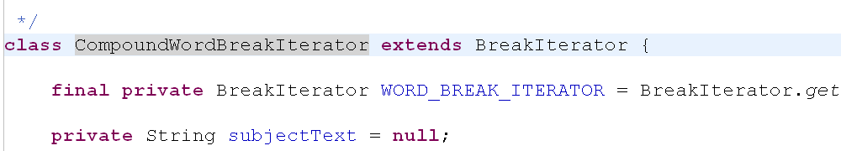
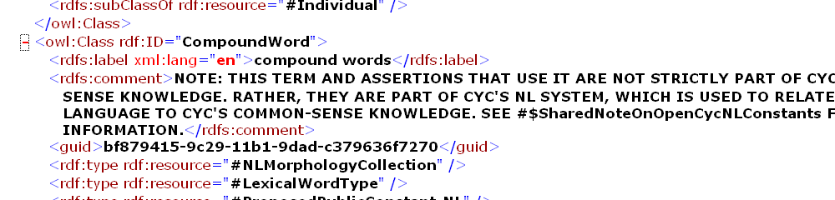
Future works (cont.) Link Models and Ontologies
Concept X
Concept Y
For program mining, validation…

Slide 43
Thank you and Q&A!

